Slide 1
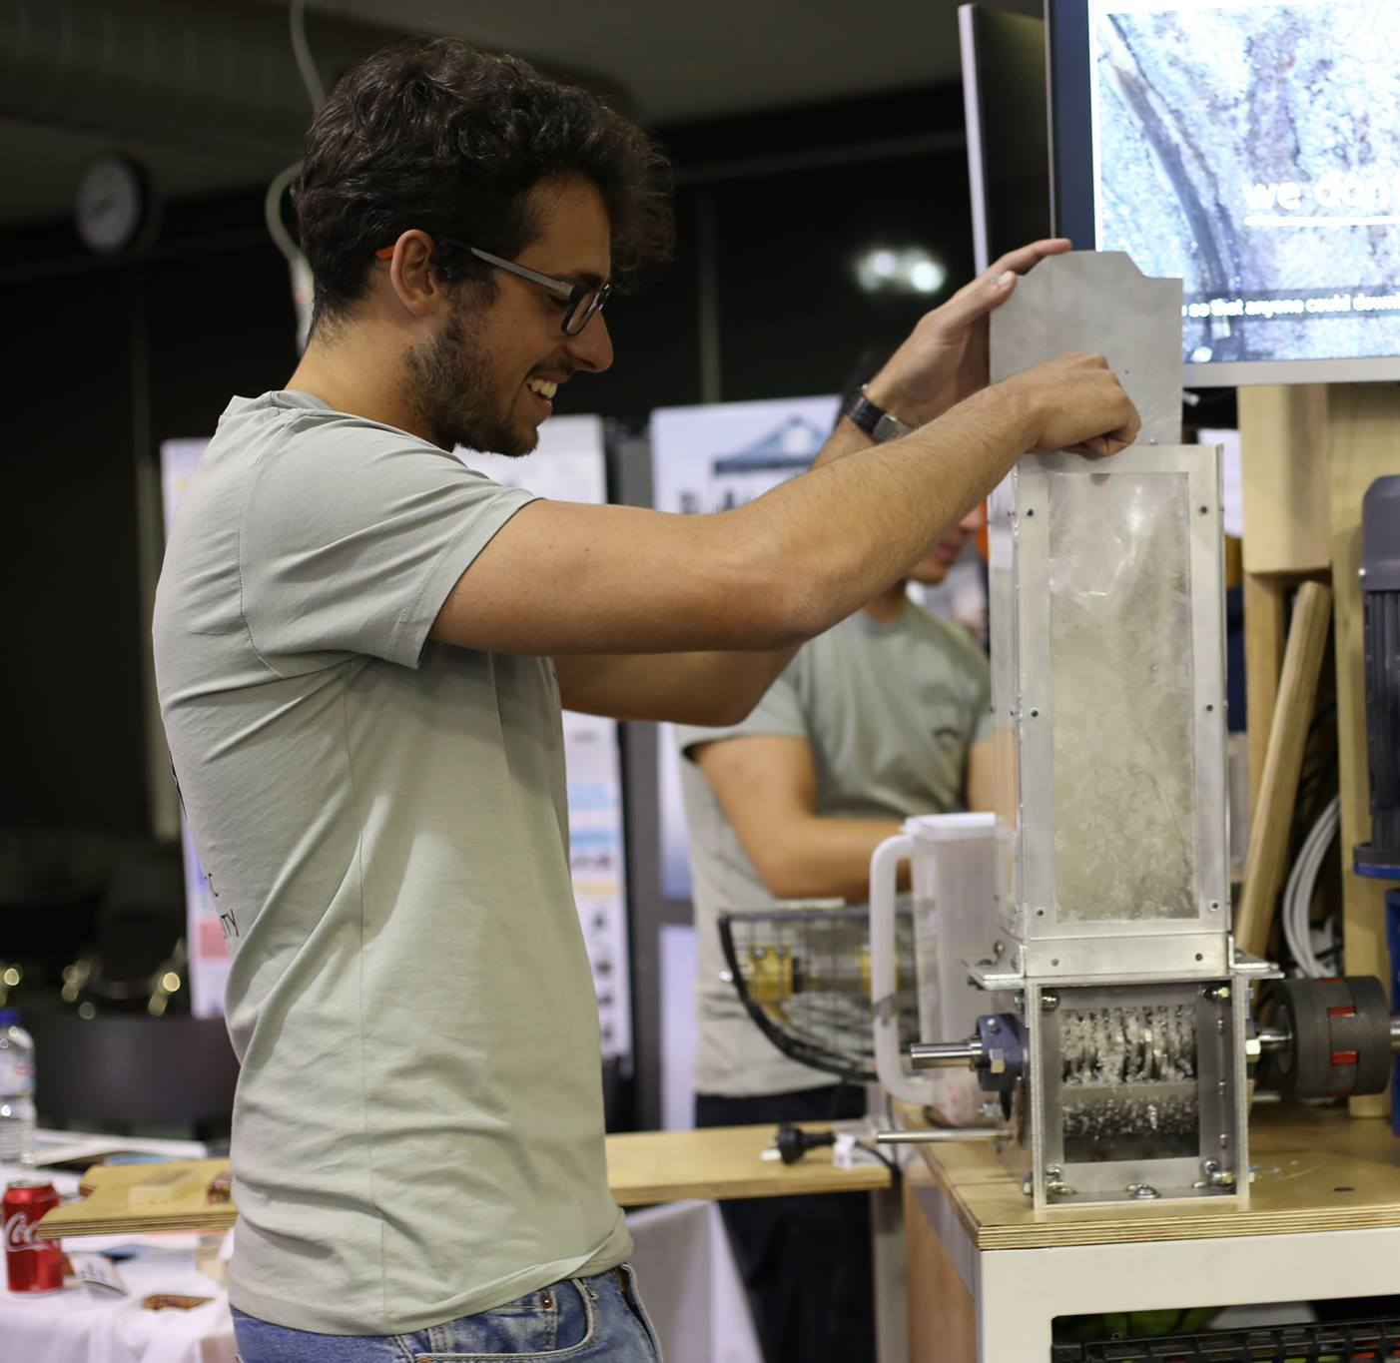


Monash University
Notes:
Slide 1
Duration: 1 minute
Welcome the audience
Introduce the team
For each person “Hi my name is XX and I am studying XX at Monash University”
Today we are excited to introduce our Plastic Recycling Integration Unit

Slide 2

Outline
Precious Plastic Monash
Recycling at home
Global Plastic Problem
Precious Plastic Initiative
What does Open-source mean?
What is the Integration Unit?
Recycling Game
Workshop Demonstration
Notes:
Slide 2
Duration: 30 seconds
Today we’ll be talking about who we are, recycling at home, plastic recycling problem, what is an open source platform, who are precious plastic monash and a demonstration of of Integration Unit

Slide 3
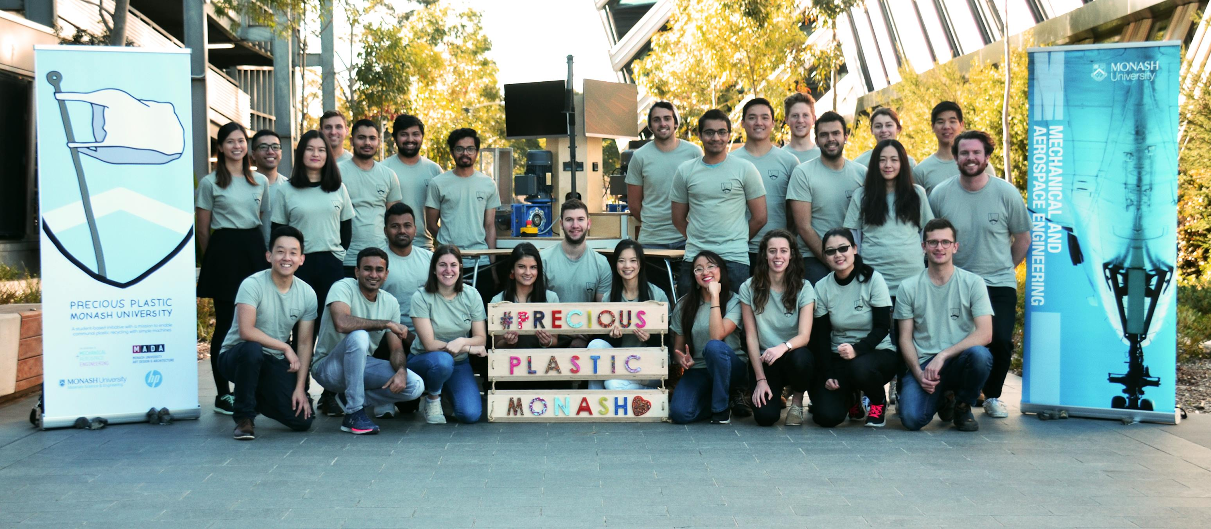
Who are Precious Plastic Monash?
Notes:
Slide 3
Duration: 20 seconds
PPM are a group of 40 Monash University students studying Engineering, Science, Industrial Design and Commerce, focusing on engagement and education with our recycling machines.

Slide 4
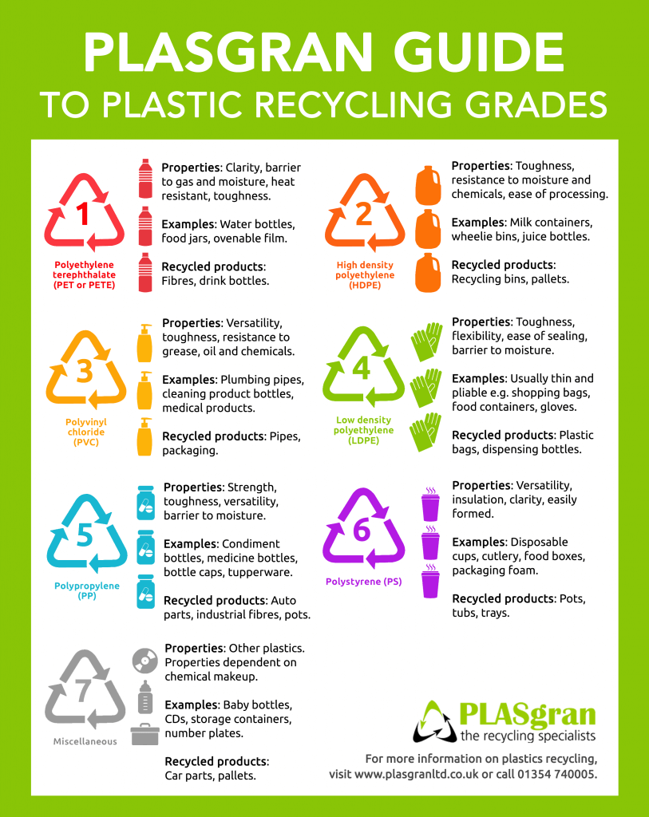
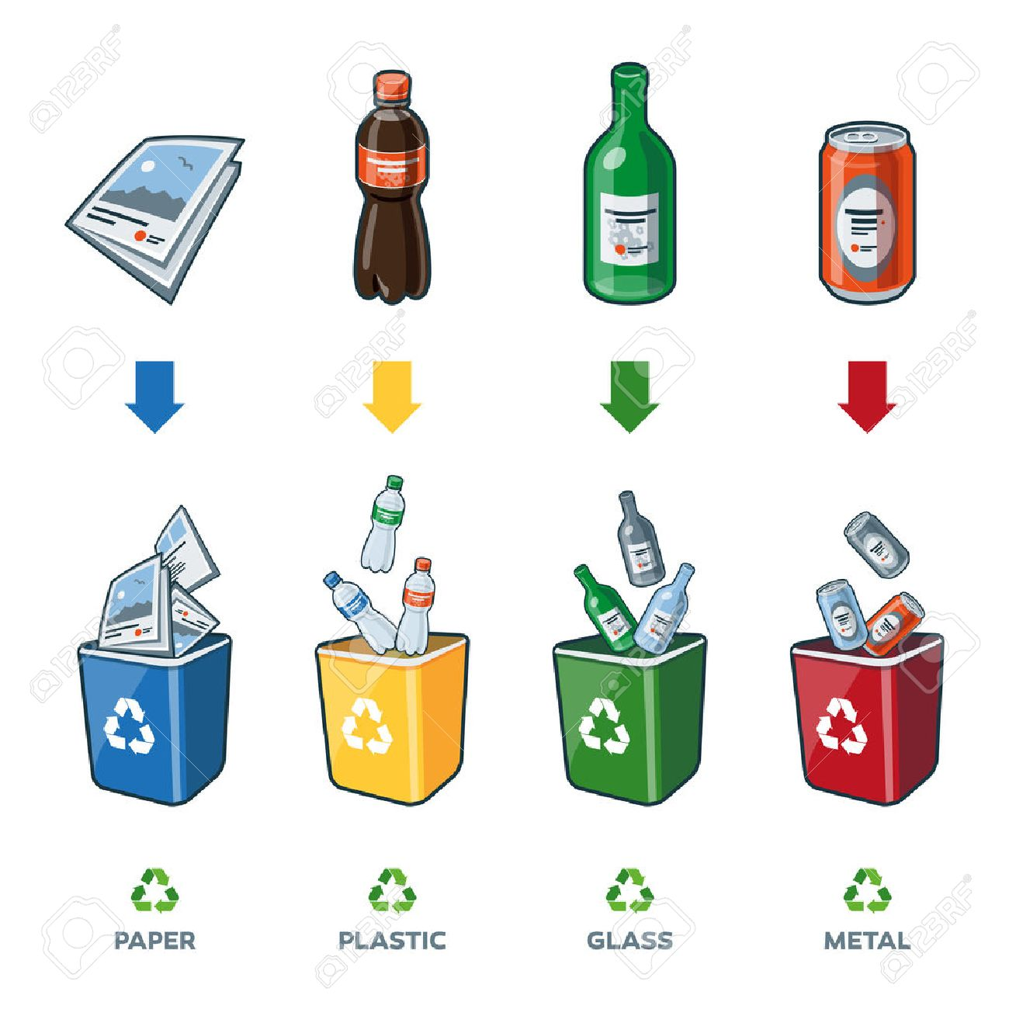
Recycling at home
www.sustainability.vic.gov.au
Notes:
Slide 4
Duration: 2-3 minutes
Open the discussion and interact with audience:
“Who recycles at home?”
“What do you recycle?”
“Do you recycle plastic?”
“Do you know what plastics can be recycled?”
Depends on your council as each of them have different rules
But in general plastic shopping bags, soft plastic packaging and polystyrene cannot be recycled in regular household bins but they can be recycled elsewhere
Eg. plastic bags can be collected and disposed of at your local supermarkets, (number 4 symbol)
Eg. polystyrene can be disposed of at specific drop off points (number 6 symbol)

Slide 5
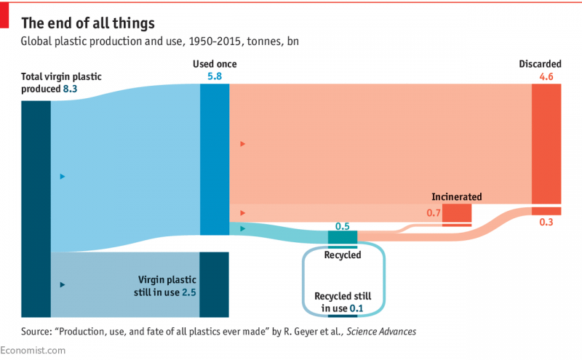
Global Plastic Problem
Only 9% of all plastic produced has been recycled
Notes:
Slide 5
Duration: 20 seconds
According to the recent study in the peer-reviewed journal “Science Advances”, (also quoted by National Geographic, The Economist, The Guardian and many more), only 9% of all plastic produced globally has been recycled, 79% of single use plastic is ending up in landfill.
References:
https://www.theguardian.com/commentisfree/2018/jun/09/recycling-plastic-crisis-oceans-pollution-corporate-responsibility
http://www.abc.net.au/news/2017-05-24/what-plastics-can-i-recycle-war-on-waste/8548658
https://www.economist.com/graphic-detail/2018/03/06/only-9-of-the-worlds-plastic-is-recycled
https://news.nationalgeographic.com/2017/07/plastic-produced-recycling-waste-ocean-trash-debris-environment/

Slide 6
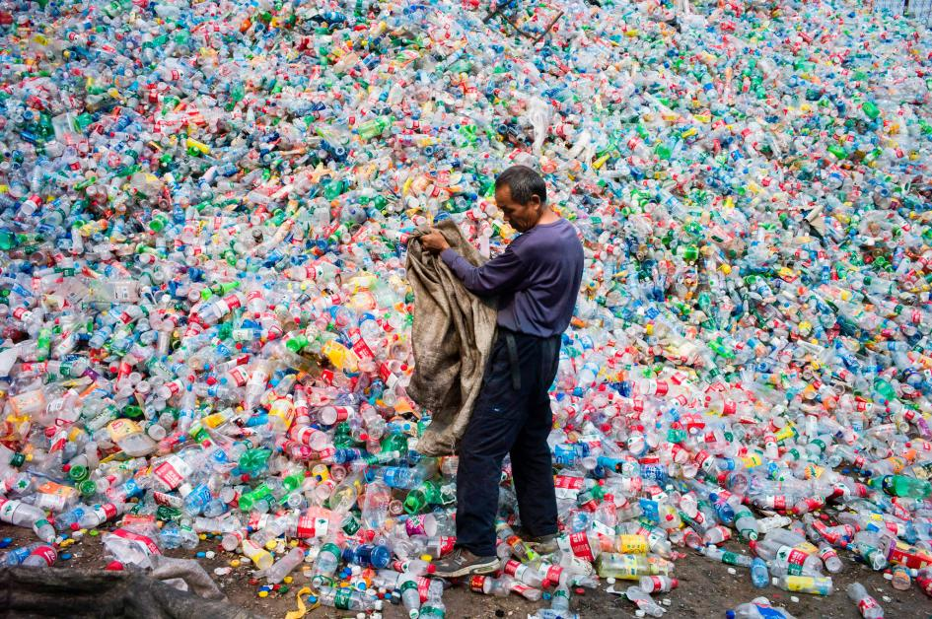
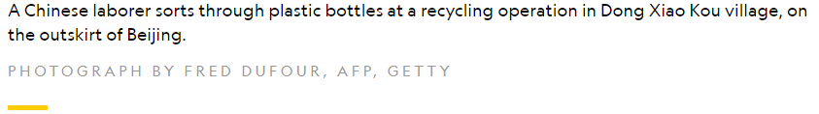
Plastic problem in Australia
Notes:
Slide 6
Duration: 20 seconds
ABC article (3 March 2018, Recycling in Australia is in crisis. Can is be fixed?) On 1st January 2018, China stopped accepting Australia’s recyclable plastics because compliance standards were lowered to 0.5% contamination which is nearly impossible to adhere to.
ABC article (15 April 2018, Australia needs to start recycling and reusing its own waste, says industry struggling under China’s ban) “The latest available data shows that Australia sent 1.2 million tonnes of waste to China in 2016-2017”, “about 30 percent of Australia’s recyclable waste is exported to China”
References:
https://news.nationalgeographic.com/2017/07/plastic-produced-recycling-waste-ocean-trash-debris-environment/
http://www.abc.net.au/news/science/2018-03-03/recycling-industry-in-crisis-can-it-be-fixed/9502512
http://www.abc.net.au/news/2018-04-15/australia-tossing-up-circular-approach-to-its-waste/9657342
http://www.abc.net.au/news/2018-02-08/the-demise-of-kerb-side-recycling/9407650

Slide 7
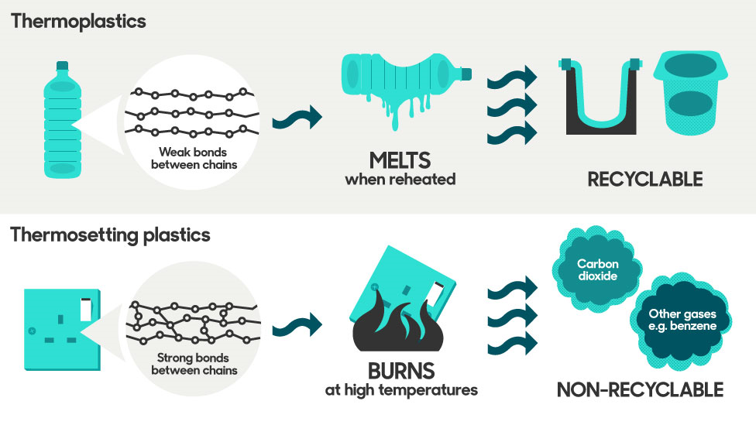
Notes:
Slide 7
Duration: 1 minute
So what is plastic? It's everywhere around us, but what is it?
Plastic is made from fossil fuels and often look the same but have different properties
There are thousands of different types of plastic but we can narrow it down to 2 categories: Thermoplastic and Thermoset
The primary difference between the 2 is that thermoplastic can be remelted back into a liquid, whereas thermoset plastic always remains in a permanent solid state.
This is because of the weak forces of attraction between polymer chains in thermoplastic, and strong polymer chains held by covalent cross-link bonding in thermosets
References:
http://www.bbc.co.uk/guides/z9tysg8
https://secondaryscience4all.wordpress.com/2014/08/12/polymer-structure-and-intermolecular-forces/

Slide 8

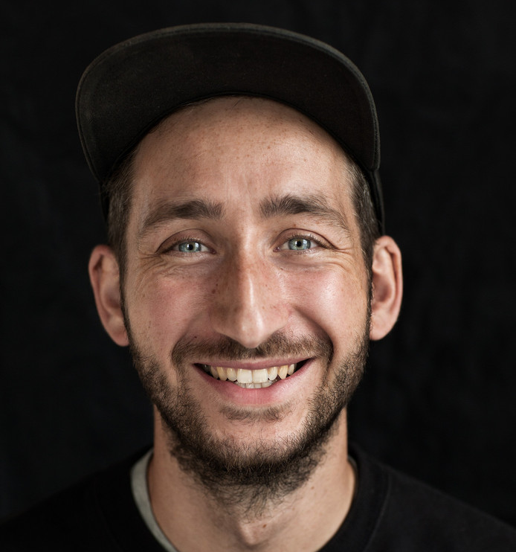
What is Precious Plastic?
Notes:
Slide 8
Duration: 1 minute
Dave Hakkens started the Precious Plastic initiative in 2013 to tackle the plastic pollution problem. His goal was to change the way we recycle plastic on a local level, encouraging open source collaboration
Tackle plastic pollution by designing machines and making the machine blueprints open source for anyone to download and make them for plastic recycling.
Dave and his team documented experiments to share knowledge, tools and techniques to help people in their recycling journey.
He envision Precious Plastic to be self sustaining by the community to collaborate and tackle to plastic problem we are all facing.
References:
https://preciousplastic.com/

Slide 9

What does Open Source mean?
Notes:
Slide 9
Duration: 20 seconds
Open Source model is defined as something that is free to access, freedom to redistribute, freedom to modify and no discrimination of person or groups.
It originated from software code and has been adopted for different applications online, such as machine blueprints.
References:
Picture: https://www.udsenterprise.com/en/blog/2018/02/09/open-source-trends-2018/

Slide 10
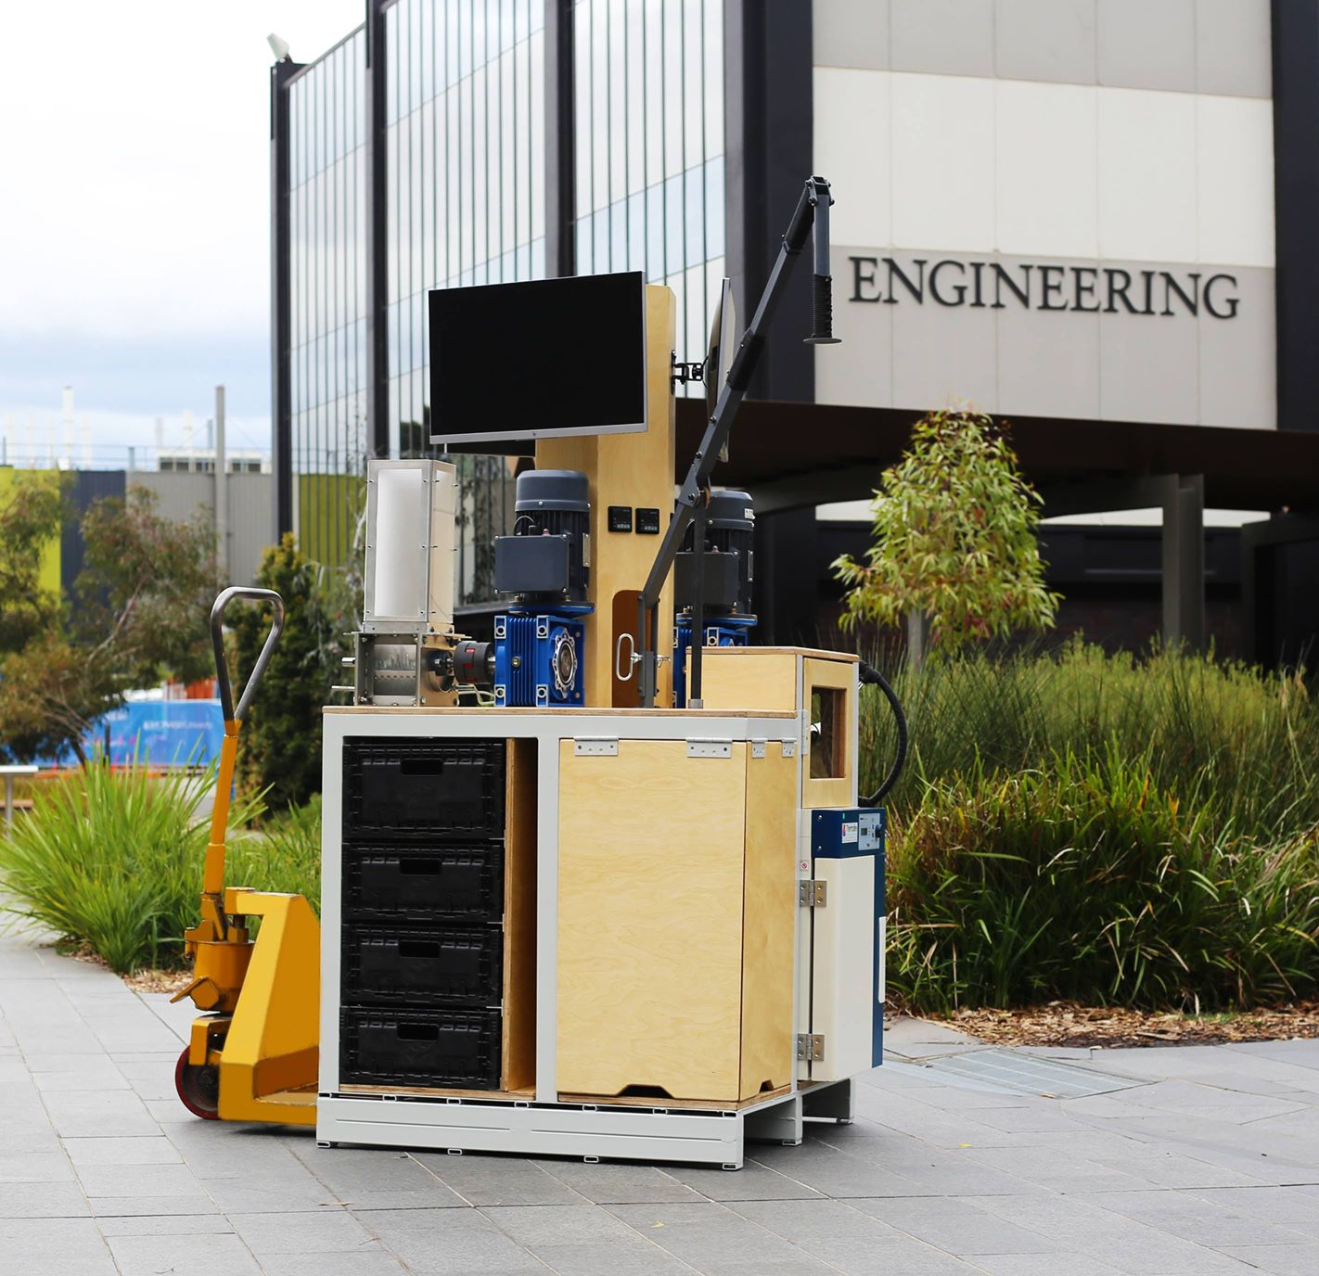
Precious Plastic Monash Integration Unit
Notes:
Slide 10
Duration: 1 minute
PPM have used the original blueprints from Dave Hakkens open source download kit and combined the 4 machines into 1 and fit on a 1x1 metre pallet
It has also been modified to include storage compartments, electrical controls, audio visual displays and flip out workbenches.
This allows the machines to be transportable for education and engagement purposes

Slide 11
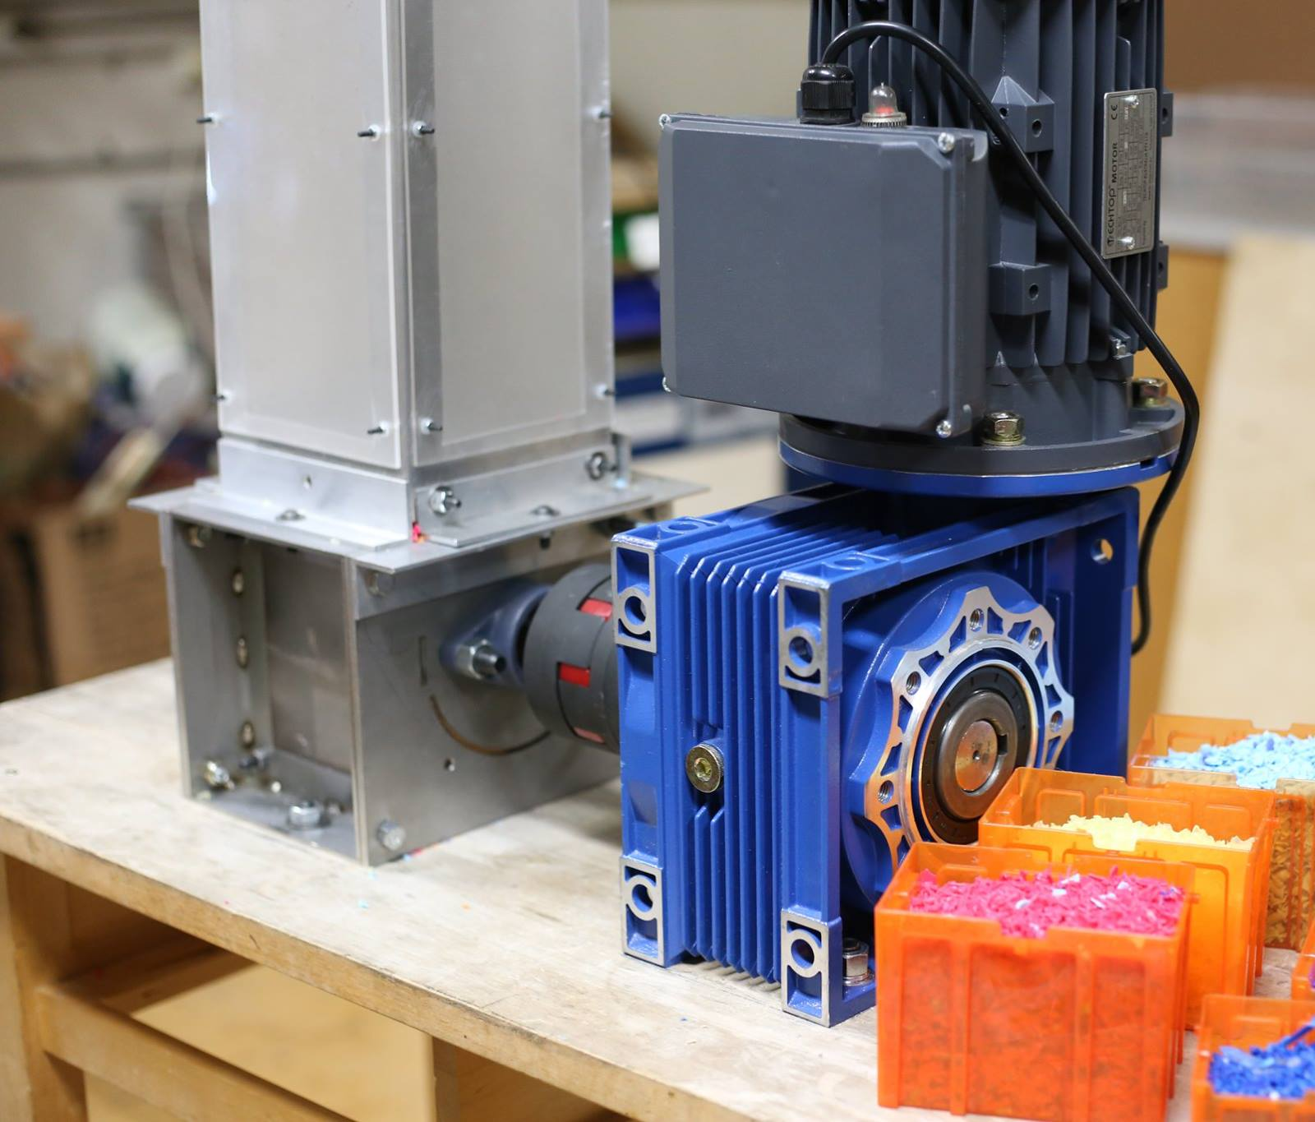
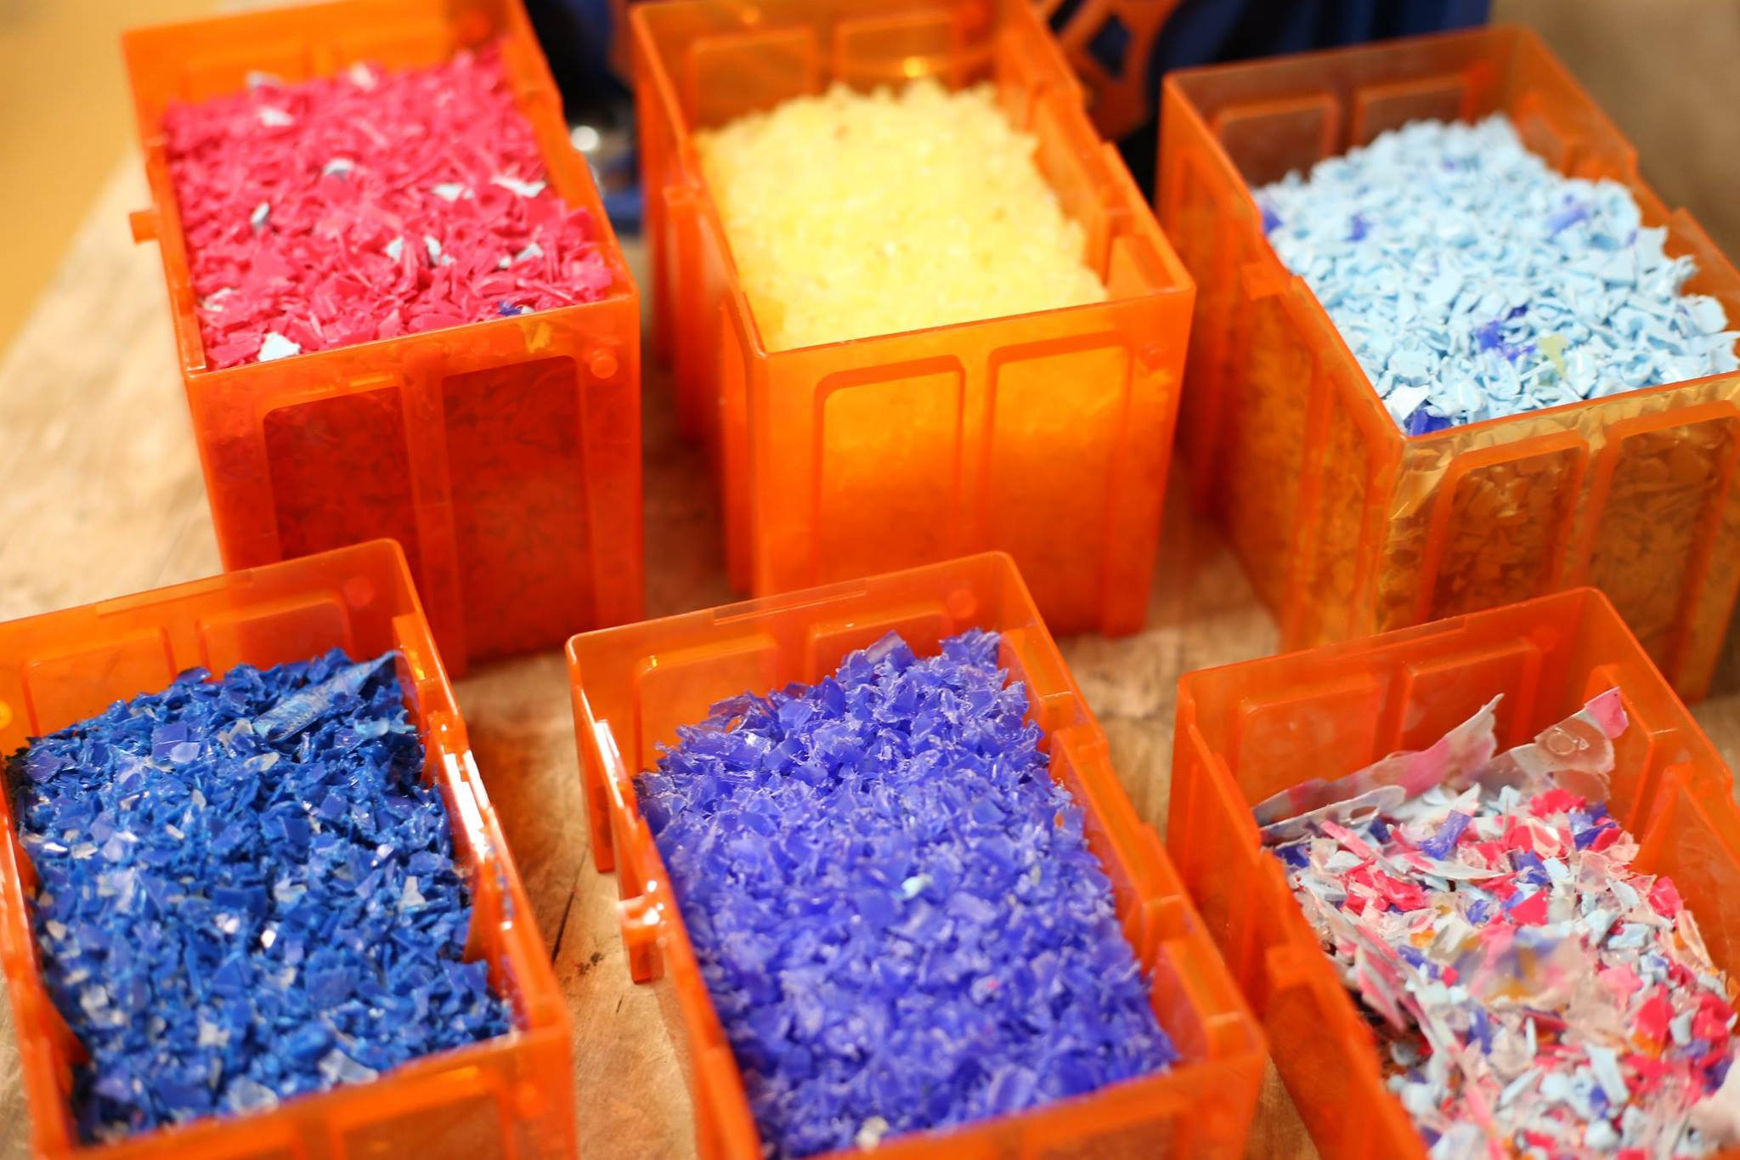
Shredder
Shreds plastic into pellets (plastic confetti)
Notes:
Slide 10
Duration: 10 seconds
Read off slide

Slide 12
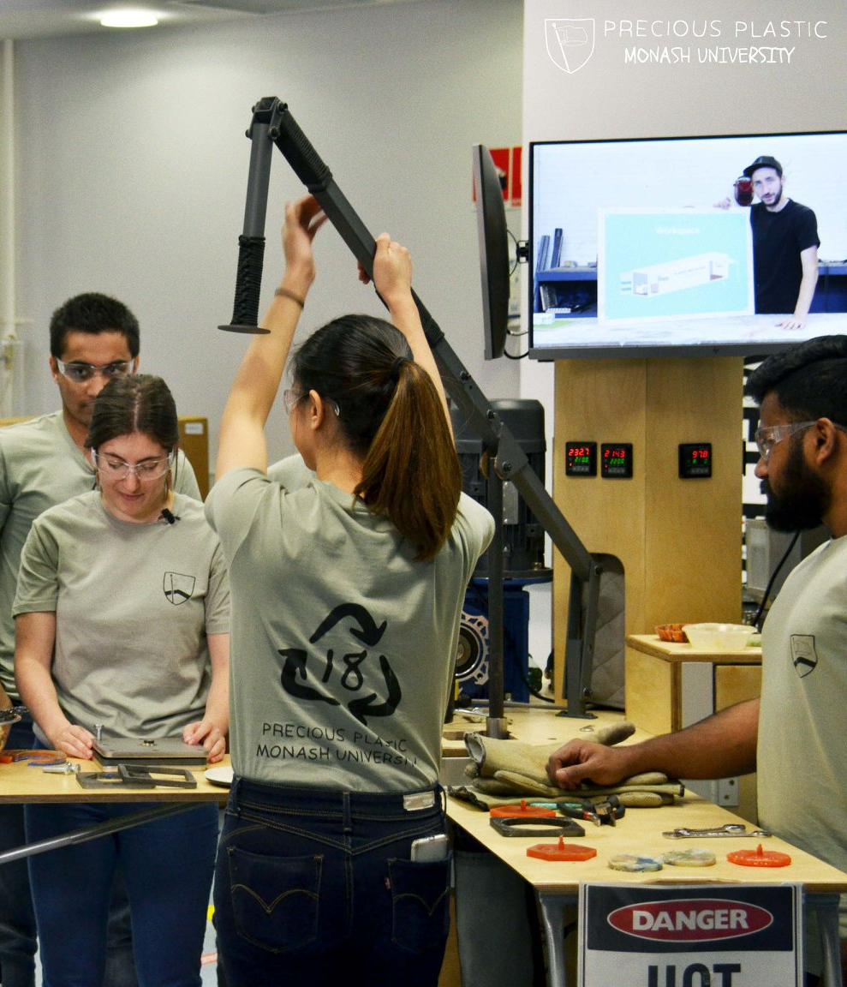
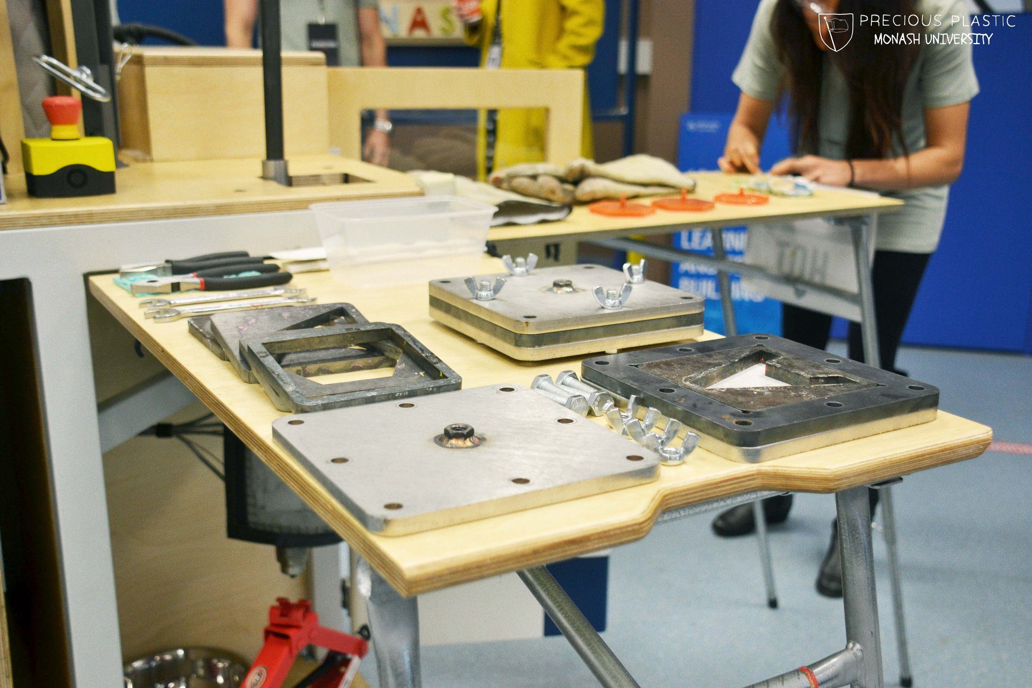
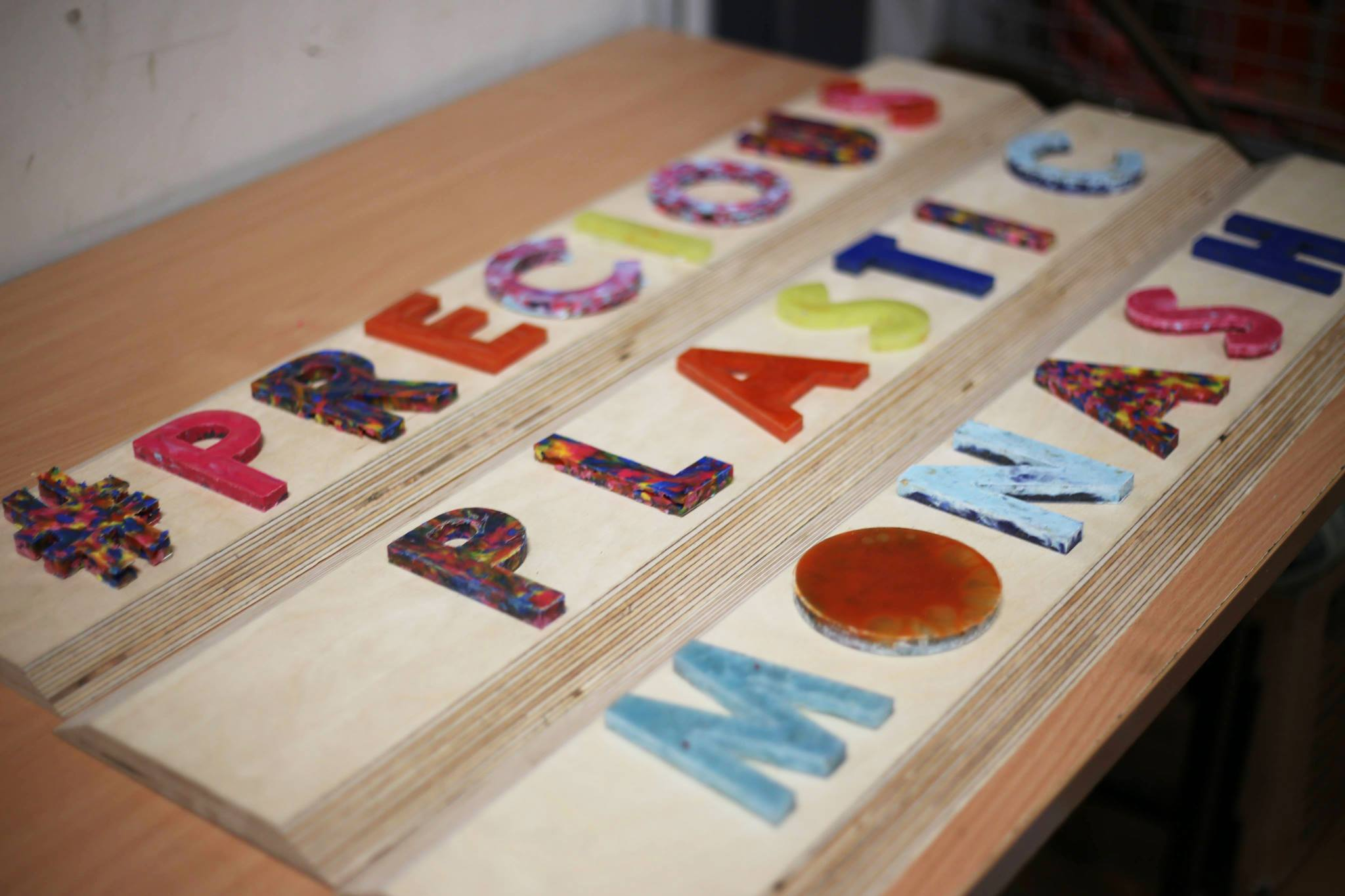
Injector
Melts plastic using heat in a barrel and injects it into mould (squeezing toothpaste)
Notes:
Slide 11
Duration: 10 seconds
Read off slide

Slide 13
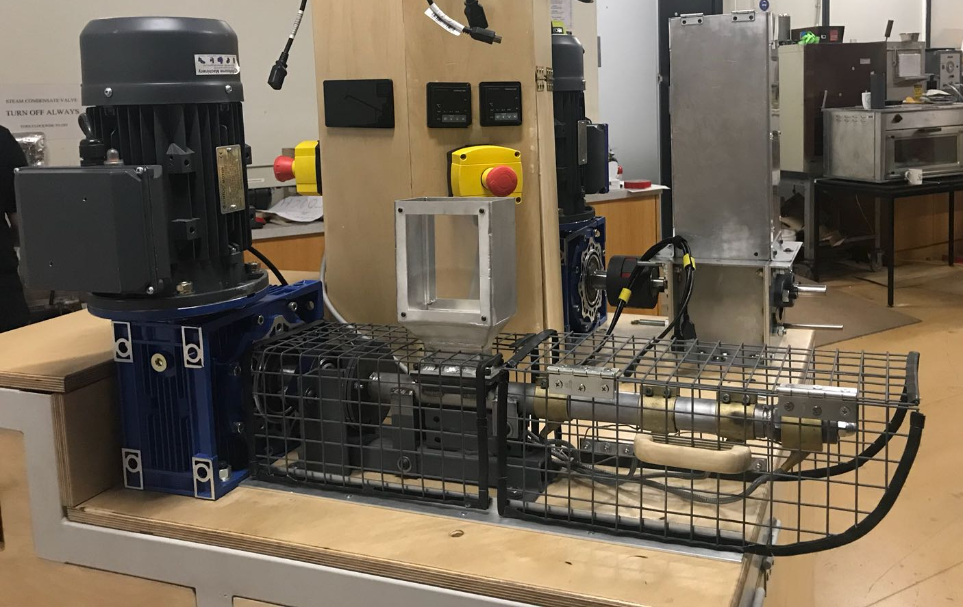
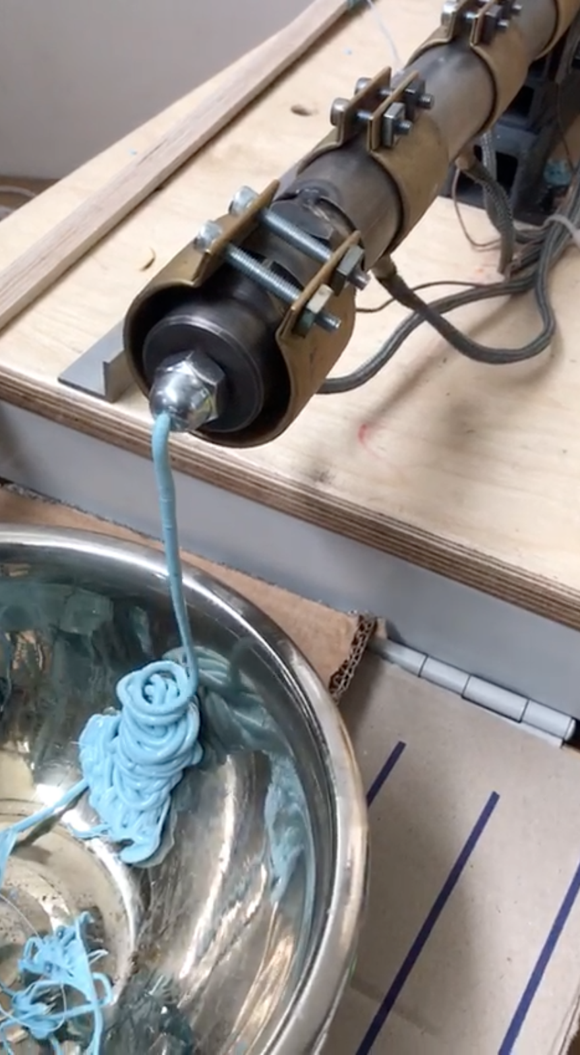
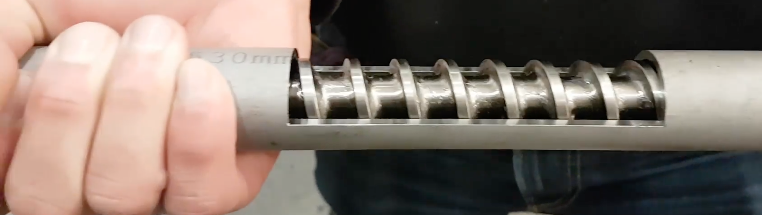
Extruder
Melts plastic using heat and extrudes a plastic filament (like spaghetti)
Notes:
Slide 12
Duration: 10 seconds
Read off slide

Slide 14
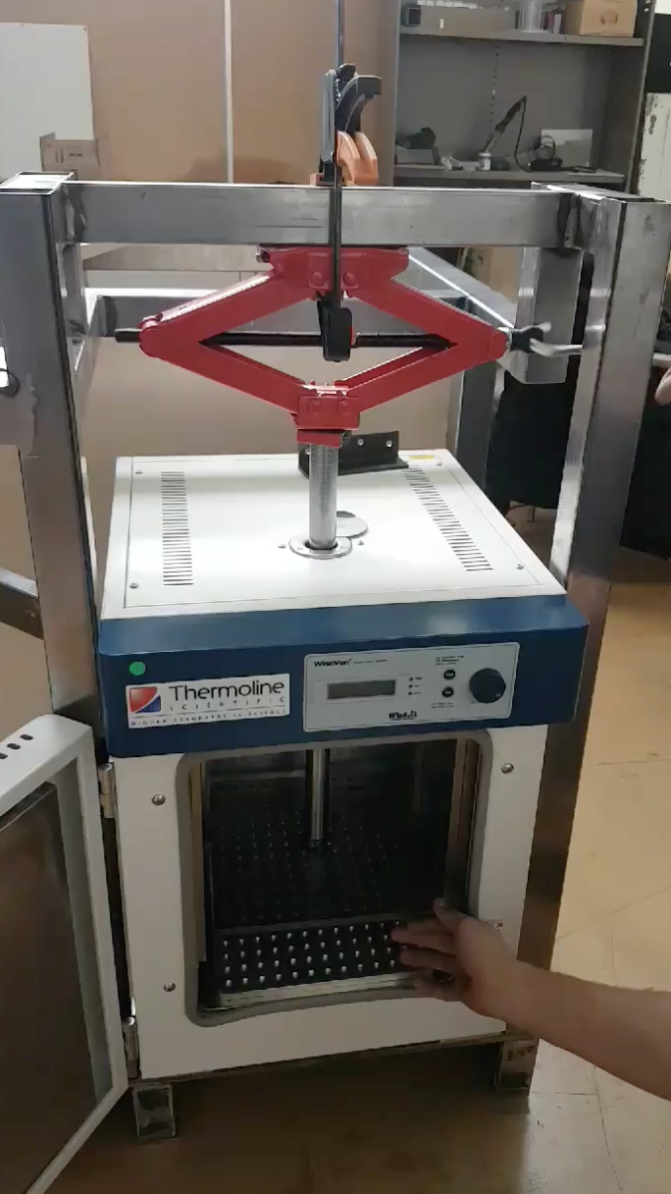
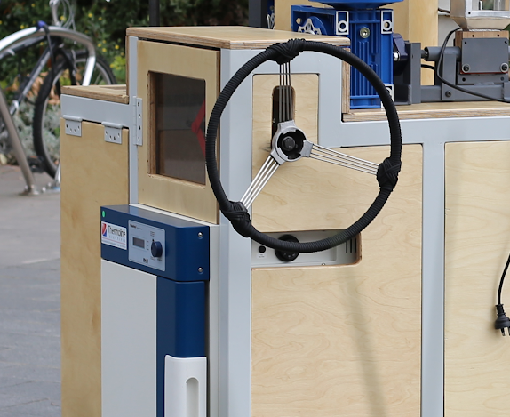
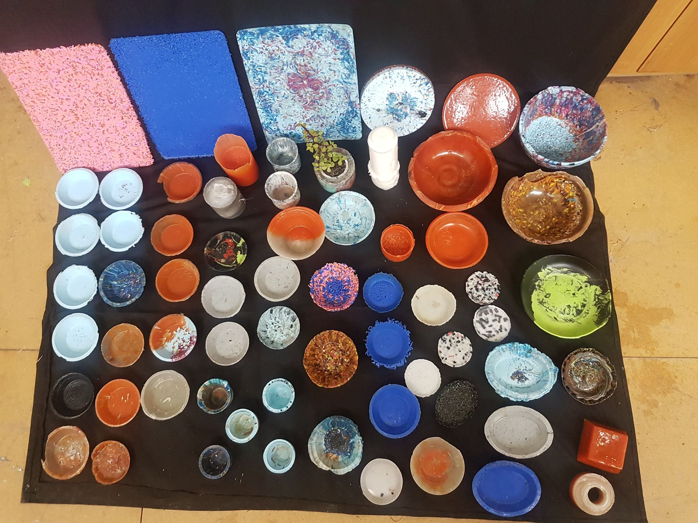
Compressor
Melts plastic using an oven and squishes moulds together
Notes:
Slide 13
Duration: 10 seconds
Read off slide

Slide 15
SO YOU THINK YOU KNOW PLASTICS?
Notes:
Slide 16
Duration
Segway into activity:
So you think you know plastic? Activity

Slide 16
Activity!
ASK QUESTION
Did the team answer the question correctly?
yes
no
RECYCLE
Did the player recycle correctly?
KEEP WASTE
and
CHANGE PLAYER
yes
no
1 POINT :)
Waste gets recycled
0 POINTS :(
Waste goes to landfill
Notes:
Duration 20 minutes
So you think you know plastic? Activity

Slide 17
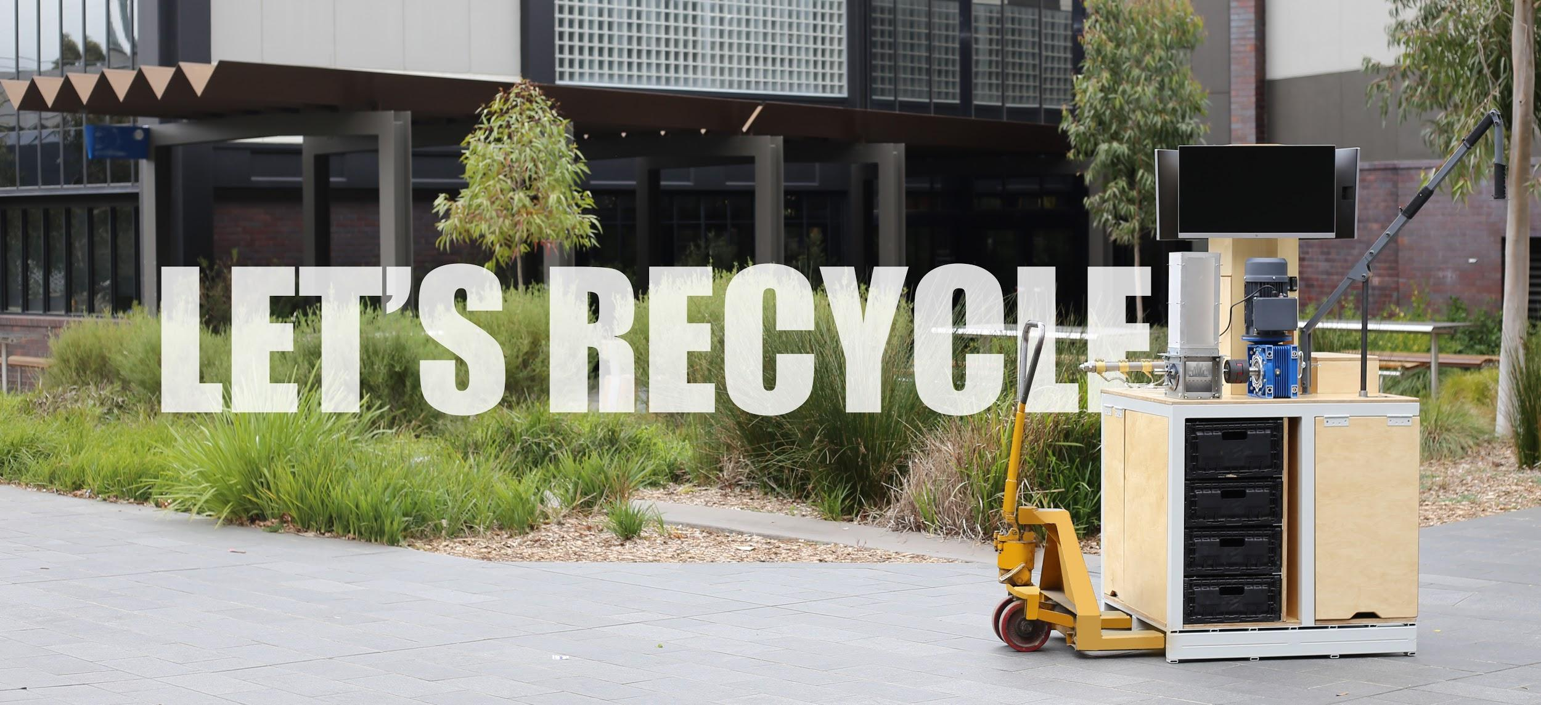
LET’S
RECYCLE
Notes:
Slide 15
Duration: 20 minutes
Segway into activity:
Invite audience to volunteer to use the machines

Slide 18




Materials Science & Engineering
Notes:
Slide 18
Sponsors

Slide 19



@preciousplasticmonash
Notes:
Slide 18
Feedback

